Slide 1
Running on the path less traveled:
Examining the emergence and evaluation of unconventional female candidates
Taylor Gordon
Political Science and Statistics
Advisors:
Dr. Monica Schneider
Associate Professor, Department of Political Science
Dr. Kevin Reuning
Assistant Professor, Department of Political Science

Slide 2
Introduction
Most members of Congress are elected via “conventional” routes:
Previously worked in law, business, education, or politics (Lawless and Fox 2010).
Women are more likely than men to embody “unconventional” political candidacies (Sanbonmatsu and Carroll 2013).
Prior research tells us:
Women’s emergence as candidates is conditioned on other characteristics (Silva and Skulley 2018).
Gender only affects voter attitudes under certain conditions (Schneider and Bos 2019).
I examine how a congressional candidate’s gender and pathway to office interact to influence candidate emergence and voter evaluations.

Slide 3
Data and Methods
To examine candidate emergence I compiled an original data set:
1,887 candidates
75% male, 56% Democratic, 78% white
61% conventional, 23% semi-conventional, 16% unconventional
District-level demographic data
Emergence by gender was predicted using the district-level data and relevant controls.
To examine voters’ attitudes I conducted an experiment:
305 participants
46% male, 49% Democratic, 78% white
2(gender) x 2(conventionality) factorial design
Respondents were asked to rate candidates’ qualifications, approachability, and favorability.

Slide 4
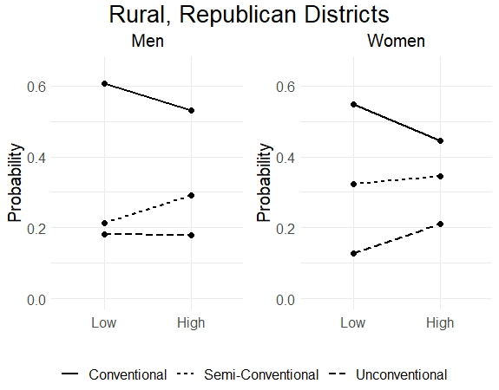
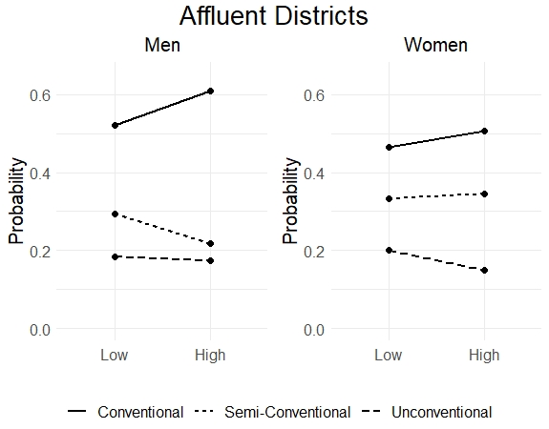
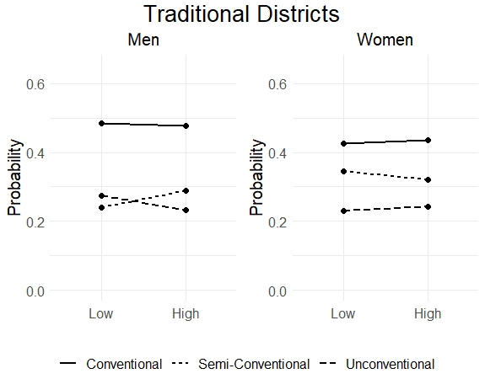
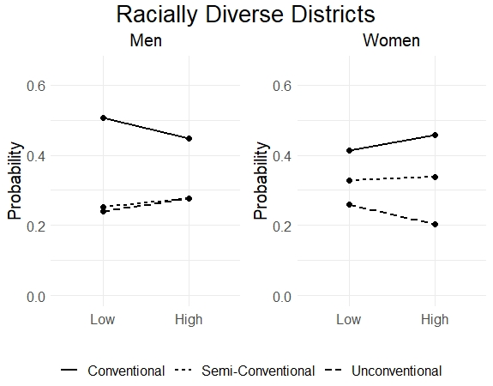
Major Findings
More women (43%) than men (38%) defined as semi-conventional or unconventional.
Candidate emergence is dependent upon both pathway to office and gender.
Conventional candidates are more consistent in their emergence patterns.
Unconventional female candidates deviate from the patterns of both women (Palmer and Simon 2008) and unconventional candidates.

Slide 5
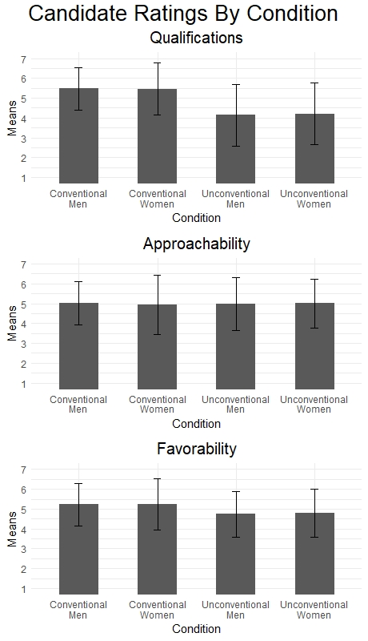
Major Findings
Pathway to office has a stronger influence than gender.
Conventional candidates are perceived as more qualified but no less approachable than unconventional candidates, regardless of gender.
Voters prefer candidates they perceive as highly qualified (McDermott 2005), regardless of gender.
Qualifications
Gender
Pathway to Office
Favorability

Slide 6
Conclusions
Unconventional female candidates face unique challenges which can impact where they emerge, but the largest challenge they appear to face is overcoming the perception that they lack the qualifications to hold office, a perception that unites all unconventional candidates.
While gender does not appear to influence voters’ evaluations, the interaction between gender and conventionality remains important because fewer women follow conventional routes to office.
To better understand how gender influences the emergence and success of female candidates, more conditions must be explored.
Understanding the ways in which gender impacts elections can offer important insight to the challenges that women face in running for office.
.
in

Slide 7
References
Carroll, Susan J., and Kira Sanbonmatsu. 2013. More Women Can Run: Gender and Pathways to the State Legislatures. Oxford: Oxford University Press.
Lawless, Jennifer L., and Richard F. Fox. 2010. It Still Takes a Candidate: Why Women Don’t Run for Office. New York: Cambridge University Press.
McDermott, Monika L. 2005. “Candidate Occupations and Voter Information Shortcuts.” The Journal of Politics 67(1): 201–19.
Palmer, Barbara, and Dennis Simon. 2008. Breaking the Glass Ceiling: Women and Congressional Elections. 2nd ed. New York: Routledge.
Schneider, Monica C., and Angela L. Bos. 2019. “The Application of Social Role Theory to the Study of Gender in Politics.” Political Psychology 40(S1): 173–213.
Silva, Andrea, and Carrie Skulley. 2018. “Always Running: Candidate Emergence among Women of Color over Time.” Political Research Quarterly 72(2): 342–59.

